Slide 1
Protecting the environment

Slide 2
The environmental situation in Russia
Environmental situation in Russia has all the basic features and manifestations of the global environmental crisis. In recent years, primarily occurs anthropogenic pollution levels which exceed the permissible.
Created on today, the environmental situation is extreme and dangerous. At present, the annual emissions of the industrial enterprises and transport in Russia are about 25 million. M. At the present time in the country there are more than 24 thousand. Companies that pollute the environment.

Slide 3
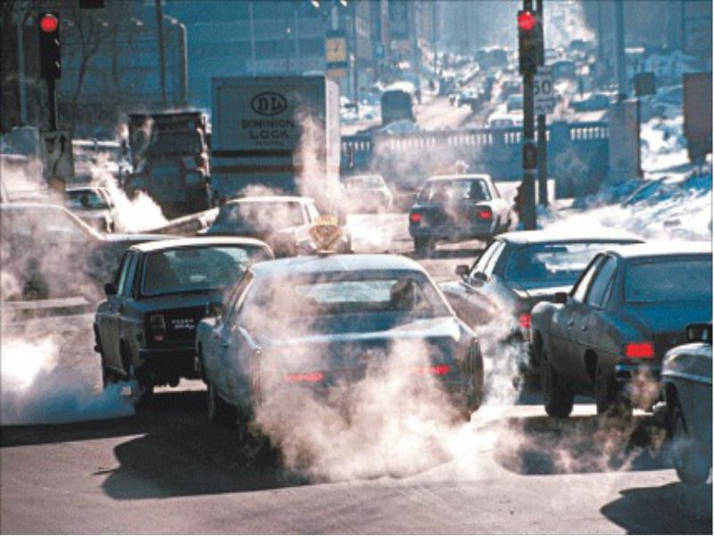
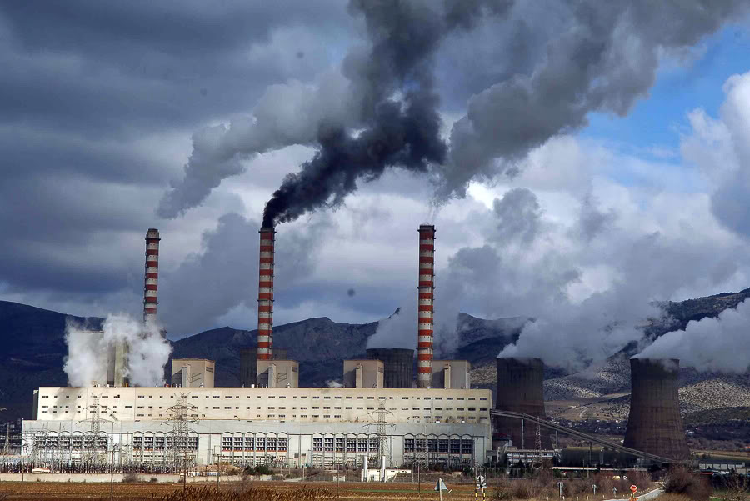
Air - one of the most important components of the environment. The main sources of air pollution are thermal power plants and heating plants that burn fossil fuels; vehicles; ferrous and nonferrous metallurgy; mechanical engineering; chemical production; mining and processing of mineral raw materials; open sources (production of agricultural production, construction).

Slide 4
Pollution of the hydrosphere
Hydrosphere pollution occurs primarily as a result of discharge into rivers, lakes and the sea of waste water.
The most polluted rivers such as the Rhine, Danube, Seine, Tiber, Mississippi, Ohio, Volga, Dnieper, Don, Dniester, the Nile, the Ganges.
Growing pollution of the oceans, which gets about 100 million. Tons of waste. The most polluted seas such as the Mediterranean, the North Sea, Irish, Baltic, Black, Azov, Japanese, Javanese, and the Caribbean. Very great harm causing oil pollution. Particularly large oil pollution of the North, Mediterranean, Caribbean Sea, Gulf, Gulf of Mexico.

Slide 5
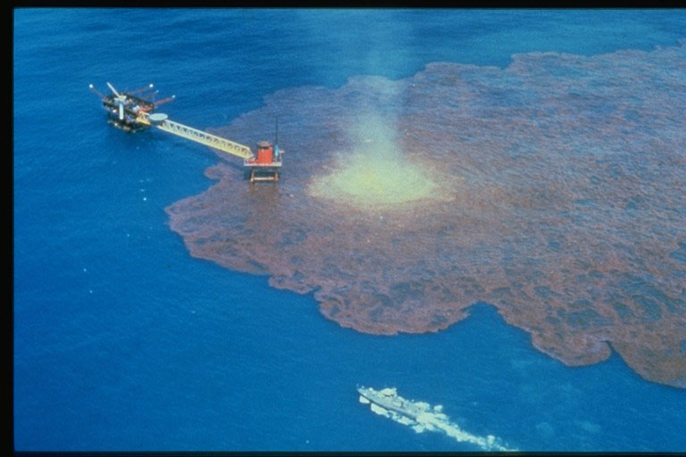
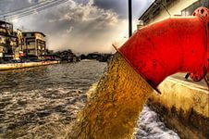

Slide 6
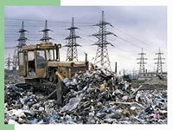
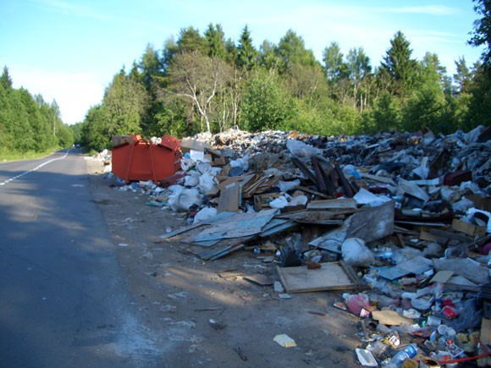
soil contamination
Vast areas of the earth's surface contaminated with human waste. Many of the toxic waste, hazardous to human and animal life. Scientists estimate that in the year one city resident throws a ton of garbage! Today more and more difficult to find a place to store even this is not very dangerous debris, such as plastic. Many waste really toxic and even radioactive.

Slide 7
three basic ways of solving environmental problems
Currently, environmental pollution has reached a size such that urgent action should be taken. There are three main ways to solve environmental problems. The first is to build sewage treatment plants, to use low-sulfur fuel, destruction and recycling of waste, construction of chimneys height of 200-300 m and more, land reclamation, etc. The second direction of overcoming environmental pollution is the development and application of nature protection ("pure") production technology, the development of working methods of water supply, etc. This route is of particular importance as it not only reduces and prevents environmental pollution. The third way - this is a deeply thoughtful, rational distribution of "dirty" industries that have an adverse impact on the environment.

Slide 8
Thank you for your attention!

